Slide 1
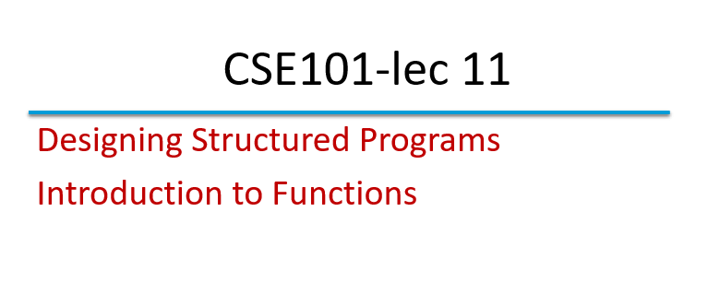

Slide 2
Divide and Conquer
Best way to solve a problem is by dividing the problem and solving it.
Divide and conquer
  Construct a program from smaller pieces or components
    These smaller pieces are called modules
  Each module more manageable than the original program

Slide 3
Program Modules in C
Functions
  Modules in C are called functions.
  Programs combine user-defined functions with library functions
    C standard library has a wide variety of functions for performing common mathematical calculations, string manipulations, character manipulations, input/output and many more.
    C standard library makes your job easier.
    Functions like printf(), scanf(), pow() are standard library functions.
    We can also write functions to define some specific task in a program and these functions are called user-defined functions.

Slide 4
Functions
Functions
  Modularize a program
  All variables defined inside functions are local variables
    Known only in function defined.
  Parameters
    Functions have list of parameters.
    Communicate information between functions.
    Are also Local variables to that function.

Slide 5
Benefits of functions
  Divide and conquer
    Manageable program development
  Software reusability
    Use existing functions as building blocks for new programs
    Abstraction - hide internal details (library functions)
  Avoid code repetition

Slide 6
Function Call
Function calls
  Invoking functions
    Provide function name and arguments (data)
    Function performs operations or manipulations
    Function returns results
  Function call analogy:
    Boss asks worker to complete task
      Worker gets information, does task, returns result
      Information hiding: boss does not know details

Slide 7
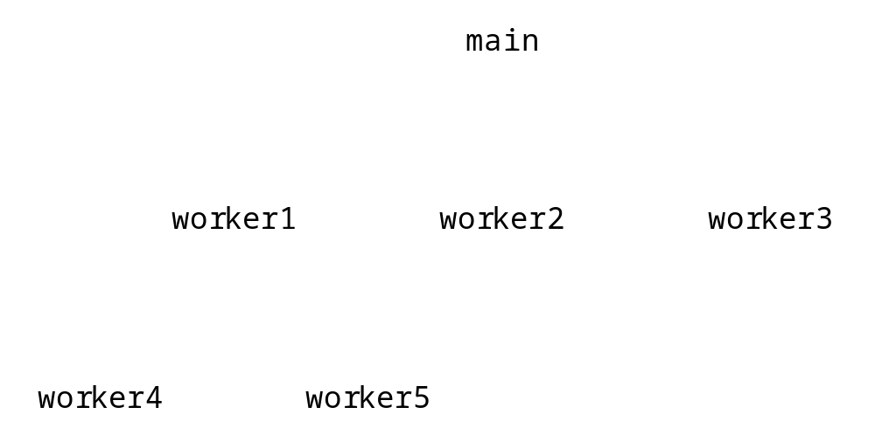
Program Modules in C
Hierarchical boss function/worker function relationship.

Slide 8
Function Definitions
Function definition format
    return-value-type function-name( parameter-list )
    {
    declarations and statements
    }
  Function-name: any valid identifier
  Return-value-type: data type of the result (default int)
    void – indicates that the function returns nothing
  Parameter-list: comma separated list, declares parameters
    A type must be listed explicitly for each parameter unless, the parameter is of type int

Slide 9
Function Definitions
Function definition format (continued)
    return-value-type function-name( parameter-list )
    {
    declarations and statements
    }
  Definitions and statements: function body (block)
    Variables can be defined inside blocks (can be nested)
    Functions can not be defined inside other functions
  Returning control
    If nothing returned
      return;
      or, until reaches right brace at the end of function.
    If something returned
      return expression;

Slide 10
Function Prototypes
Function prototype
  Function name
  Parameters – what the function takes in
  Return type – data type function returns (default int)
  Used to validate functions
  Prototype only needed if function definition comes after use in program
  The function with the prototype
    int square( int y);
    Takes in 1 int data.
    Returns an int
Promotion rules and conversions
  Converting to lower types can lead to errors

Slide 11
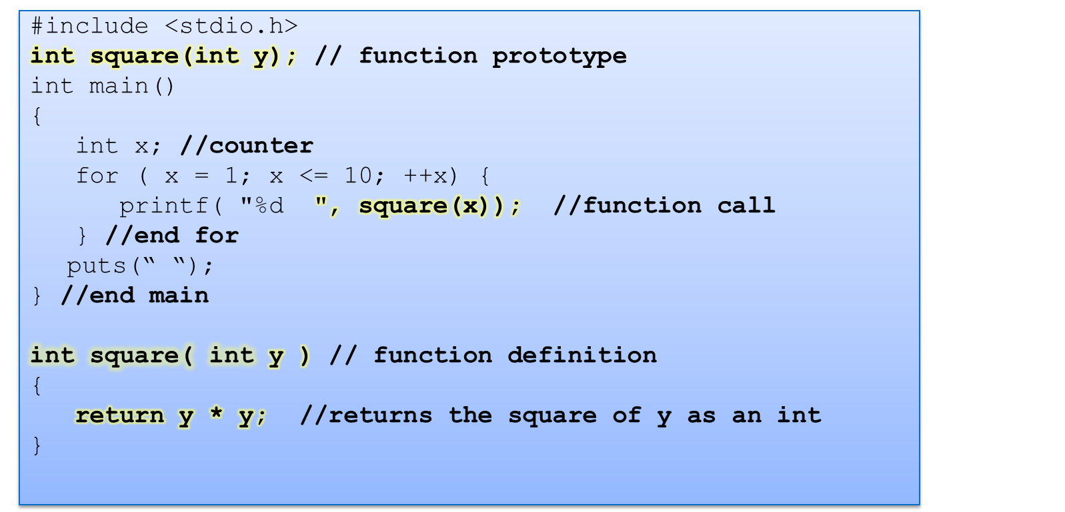
1 4 9 16 25 36 49 64 81 100

